Slide 1
Data science bootcamp t5
Airline Passenger Satisfaction

Slide 2
summary
In this project I chose a data set about an airline and my goal is to predict the level of passenger satisfaction.

Slide 3
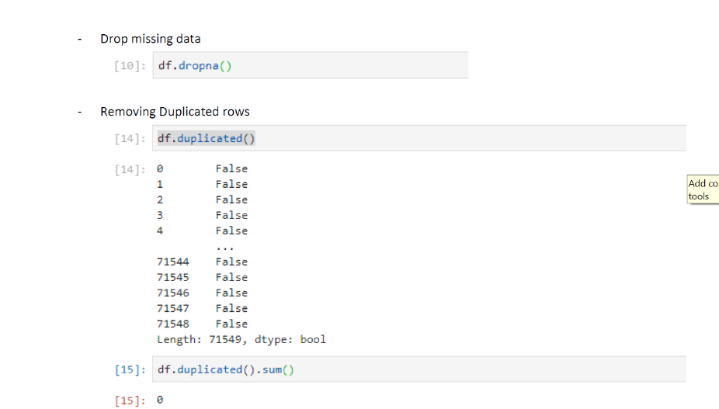
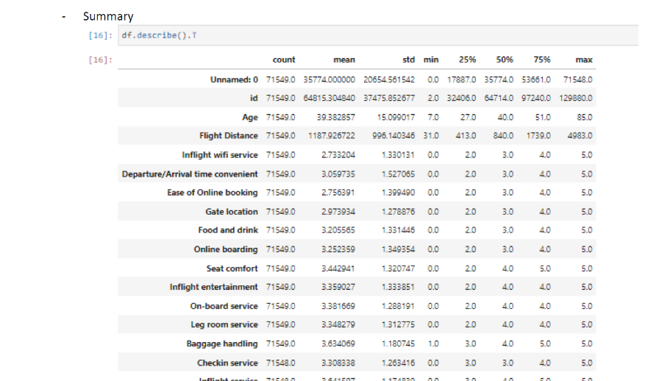
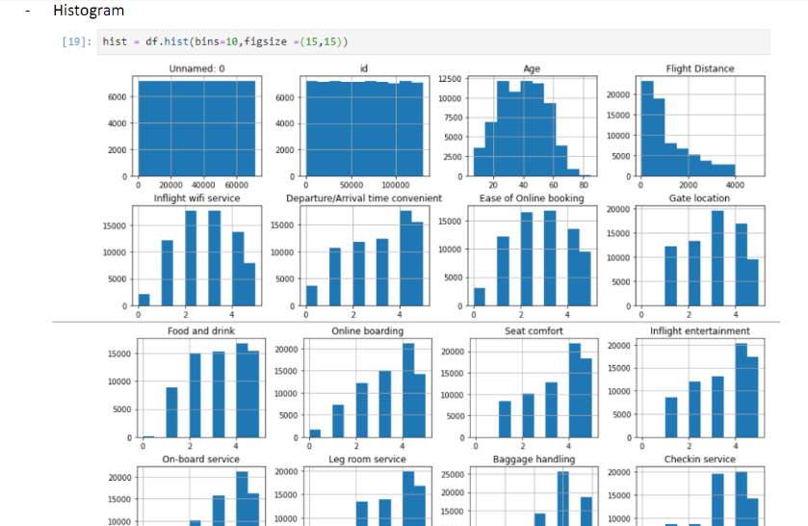
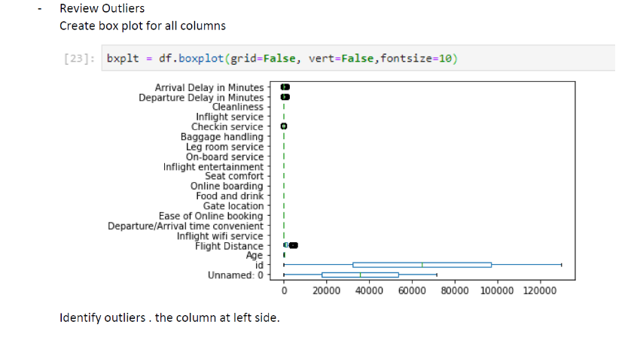
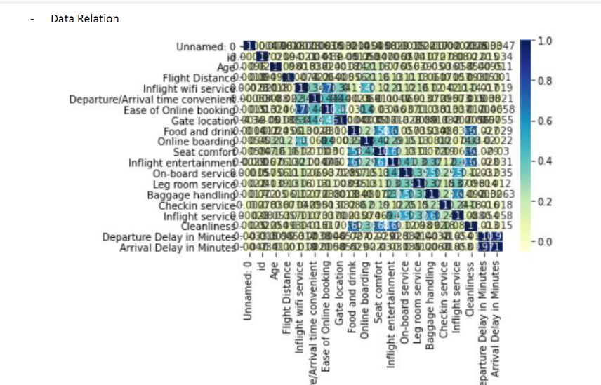
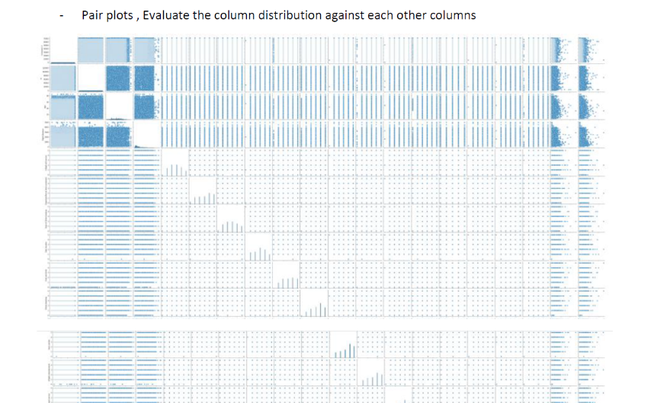
work

Slide 4
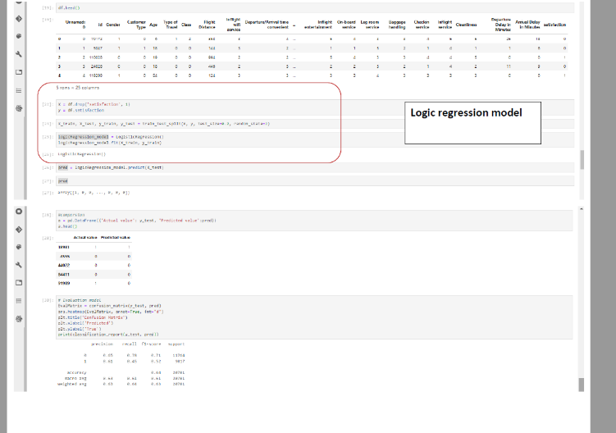
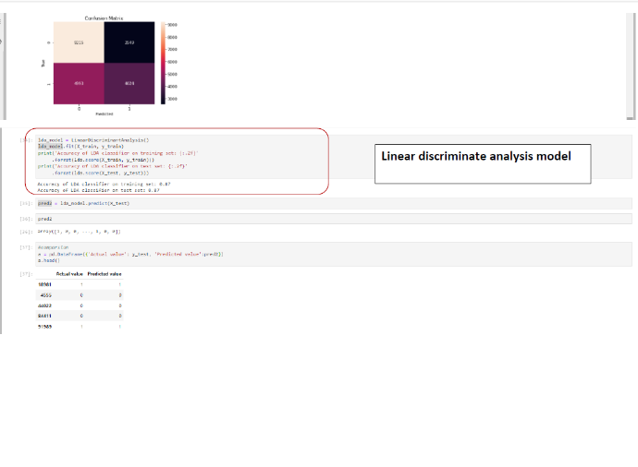
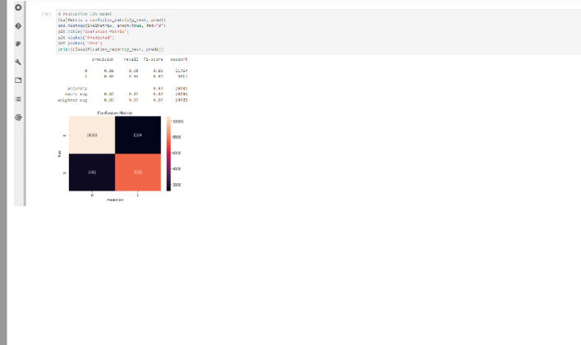
work

Slide 5
Conclusion
During the four weeks of learning, I applied what I learned in my project of data cleaning, analysis and modeling to suit my output based on my data set.

